Slide 1
AIR POLLUTION MONITORING AND ALERT SYSTEM PAVAN
GUIDED BY,
PROF. KALPANA,
ASSISTANT PROFESSOR,
DEPARTMENT OF INFORMATION TECHNOLOGY
AGILAN S 15EUIT003
FAHEEN FATHIMA B N 15EUIT030
HARISH RAJ 15EUIT036
HINDU SREENI 15EUIT040
KARTHIK U 15EUIT048

Slide 2
LITERATURE SURVEY
“IOT-based Air Pollution Monitoring and Forecasting system”, Chen Xiaojun,Liu Xianpeng,Xu Peng, International Conference on Computer and Computational Sciences (ICCCS) 2015.
IDEAS USED:
IOT based system which detects the pollution level in a particular area and predicts the outcome using algorithms.
Disadvantages:
has no integrated environment showing the levels of pollutants (less user-friendly)

Slide 3
2. “Wireless sensor network based pollution monitoring system in metropolitan cities”,Shwetal Raipure, Deepak Mehetre. IEEE ICCSP2015 conference
IDEAS USED :
Sensor combination which monitors pollution and detects the presence or absence of it. It uses NFC devices to gather and transfer data.
“Disadvantage :
uses a bluetooth support devices to gather data from the sensors which is probably a short range device.

Slide 4
WIKIPEDIA DATA
Air pollution in India is quite a serious issue with the major sources being fuelwood and biomass burning, fuel adulteration, vehicle emission and traffic congestion.
In autumn and winter months, large scale crop residue burning in agriculture fields – a low cost alternative to mechanical tilling – is a major source of smoke, smog and particulate pollution. India has a low per capita emissions of greenhouse gases but the country as a whole is the third largest after China and the United States.
A 2013 study on non-smokers has found that Indians have 30% lower lung function compared to Europeans.

Slide 5
ARTICLES
THE INDIAN EXPRESS
updated 24th January,2018
India fourth worst country in curbing environment pollution.
India ranked 177 out of 180 countries in the Environmental Performance Index’s latest rankings.
With a score of 30.57, India fares better than only three countries-Democratic republic of Congo, Bangladesh and Burundi- in curbing pollution

Slide 6
THE HINDU
Updated 12th January 2017
A greenpeace report shows 90% of cities studied had pollution levels overprescribed standards
According to an analysis of 2015 data for 168 cities by Greanpeace India, 154 were found to have an average particular matter level higher than national standard.
Delhi was found to be the most polluted city, with the annual average of PM 10 being 268 micrograms per cubic meter, or over four times the 60 micrograms/cubic metre limit prescribed in the National Ambient Air Quality Standards of the Central Pollution Control Board

Slide 7
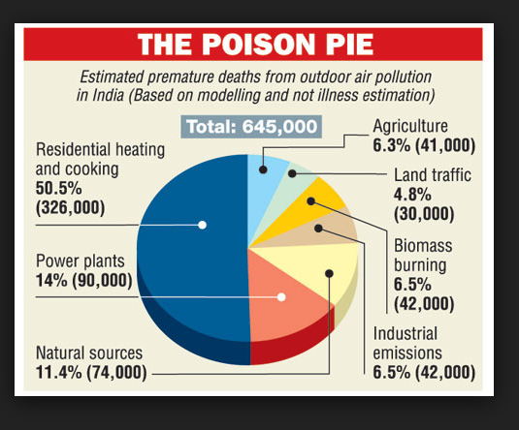
IDEAS GaTHERED
Outdoor pollution has risen 8% in five years with fast-growing cities in the developing world worst affected, WHO data shows
Government-operated pollution monitors are often expensive and therefore are few in number.
The Government has installed a single pollution monitor in most polluted cities for a million people which is awfully inadequate.
The idea of a cheaper and a simple device is always welcome in the market for installation in many places around the cities.

Slide 8
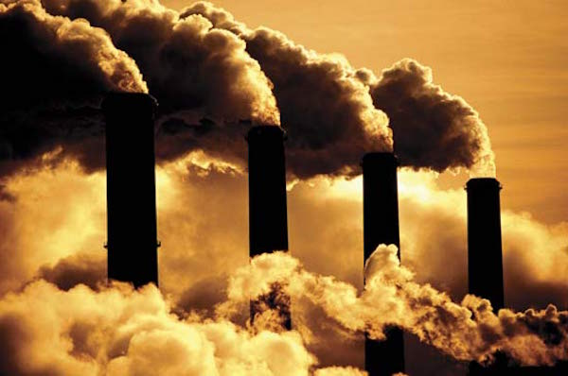
EXISTING SYSTEM
IDEAS USED
Sensor based pollution detection system in metropolitan cities
IOT based monitoring system to monitor the area with pollution.

Slide 9
DRAWBACKS OF EXISTING SYSTEM
Measures the amount of toxicity but does not provide the source of pollutants causing the pollution
Surveillance of the area for air pollution but costly mechanism comparatively
It does not provide proper means for public to access the data and also lacks interface with the sensors and front end

Slide 10
PROBLEM SYSTEM
Increase in pollution in recent years by manifold
Unawareness of the growing impact on pollution by the people
Increase in several pollutants level in air
Lack of monitoring system in localities where pollution is increasing
Lack of cheap integrated system to alert people of the increasing toxic level in air.

Slide 11
PROPOSED SYSTEM
Introducing PAVAN which is the combination of software and hardware that is used for sensing, processing and alerting the environment about the toxicity levels present in the air
An application to make normal people aware about the total pollutants and its sources.
Detecting the toxicity level of each pollutants individually in PPM.
Alerting the environmentalists about the rising dangers of air pollution using GSM/GPRS module.

Slide 12
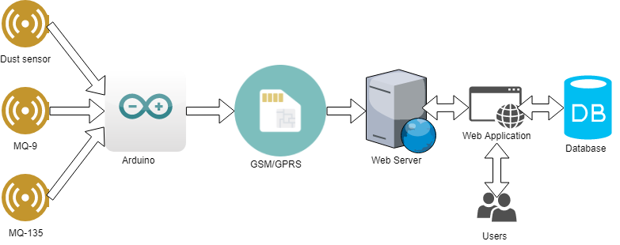
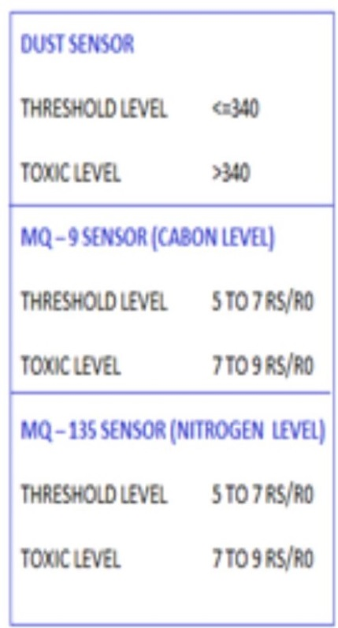
SYSTEM ARCHITECTURE

Slide 13
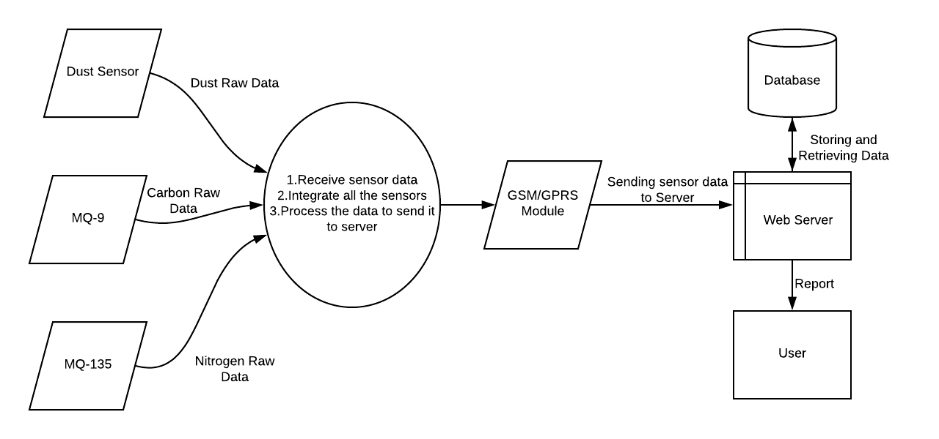
Context diagram

Slide 14
FEASIBLITY STUDY
Technical feasibility
Operational feasibility
Economic feasibility
Legal feasibility

Slide 15
Technical feasibility
Whether the required technology is available or not?
Whether the required resources are available?
Software/IDE’s available
Programming languages
Platforms available
Protocols available for network communication
Interoperability factors

Slide 16
Operational feasibility
Is the new software we are going to build is trustworthy?
Is the new software overcomes existing drawbacks?
Is the new software will pass minimum acceptance criteria’s?
Is the new software satisfies the requirement specified in SRS document?
Is the new software will bring a new era in effective decision making?

Slide 17
Economic feasibility
Includes the initial investment of
Arduino UNO
Ultrasonic sensors and other components.
Minimum requirements of the software specifications is less due to the open source tools.
Software/hardware cost
Total estimated cost of the project
Financing of the project by equal sharing between our team members
Cost-benefit analysis.

Slide 18
Legal feasiblity
To ensure that the project is legally done
To facilitate the risk management, indicating the risks and obstacles that need to be addressed within the technical analyses and financial model
To collect and process data required for the project in a legal and free of crime manner.

Slide 19
REQUIREMENTS
HARDWARE REQUIREMENTS
Arduino uno
MQ-9
MQ-135
DUST SENSOR
GSM Module
SOFTWARE REQUIREMENTS
Arduino IDE
Java SE 8

Slide 20
Modules list
Sensing the environment (sensors)
Processing the sensor data(Arduino)
Correlating the source of pollutants(GSM/GPRS module)
Storing the pollutant data(web server)

Slide 21
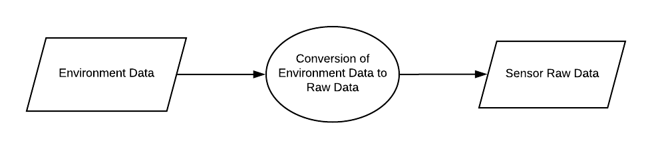
SENSORS Sensing the environment
MODULE 1

Slide 22

MODULE 2
ARDUINO Processing the sensor data

Slide 23
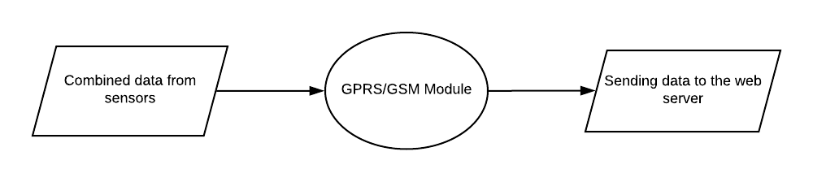
MODULE 3
GSM MODULE Correlating the source pollutants

Slide 24
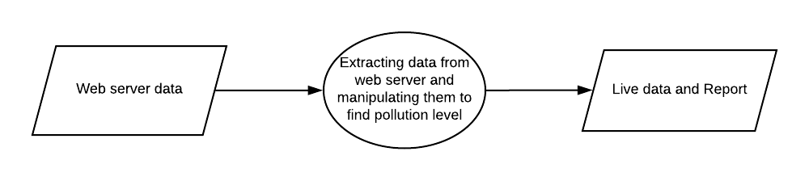
MODULE 4
WEB SERVER
Storing the pollutant data

Slide 25
Implementation

Slide 26
conclusion
Thus PAVAN provides user friendly approach towards the environmental education. It can clearly detect and alert the sudden rise in toxic level of air with proper measures and guidelines. Thus PAVAN proves to be an intelligent approach towards the protection and prevention of air pollution hazards met in the future.

Slide 27
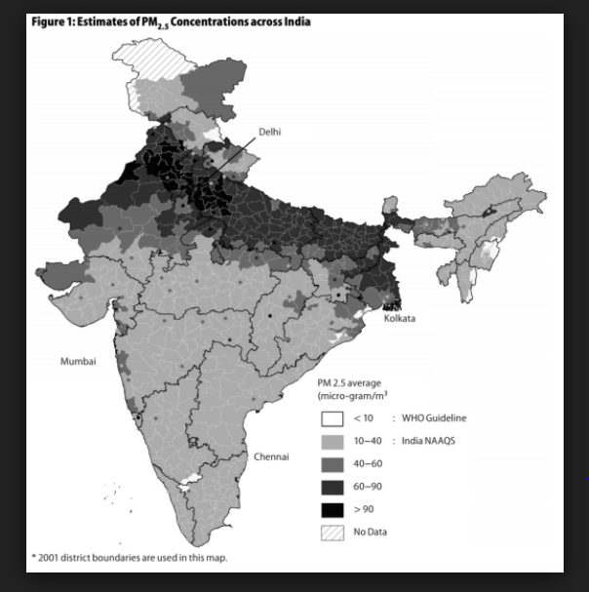
Social relevance
Pollution prevails to be a life-threatening problem that the whole world faces and hence it becomes a priority where every one has to be aware of the growing danger in the locality. Thus, the scope of PAVAN lies over all parts of the world.
PAVAN becomes an integrated system where the measure of pollutant levels can be identified uniquely for each pollutant and can be improved over the effects of toxicity it causes. Moreover, it can provide a statistical report of the toxicity in air and the vulnerability of the locality to pollution.

Slide 28
Future work
Applying machine learning algorithms to the applied statistics to estimate and foresee the toxic level in air
Developing a mobile application with the web page to provide instant access to the pollution data level.
After several years of implementation when the data acquired is manifold, data analysis can be used to handle the mass data.

Slide 29
REFERENCES
[1] “Wireless sensor network based pollution monitoring system in metropolitan cities”,Shwetal Raipure, Deepak Mehetre. IEEE ICCSP2015 conference
[2] “IOT-based Air Pollution Monitoring and Forecasting system”, Chen Xiaojun,Liu Xianpeng,Xu Peng, International Conference on Computer and Computational Sciences (ICCCS) 2015
[3] https://circuitdigest.com/microcontroller-projects/iot-air- pollution-monitoring-using-arduino
[4] http://nevonprojects.com/iot-air-sound-pollution-monitoring- system/
[5] https://www.aeroqual.com/outdoor-air-quality
[6] https://plot.ly/arduino/air-quality-tutorial/
[7] http://www.instructables.com/id/Air-Pollution-Detector/
[8] https://www.google.co.in/amp/indianexpress.com/article/
[9] https://www.google.co.in/amp/thehindu.com/article/

Slide 30
THANK YOU!

